Slide 1






DAY 1 - SESSION 1.2
TECHNOCRATS PRESENTS
Real-Time
MEDIAPIPE & COMPUTER VISION
Hand Detection
AI-Powered
21 Landmark Points
Precision
🖐️ HAND TRACKING WITH AI
Gesture Control
21
60
Ansik Singh Tomar (Aanshik)
|
COORDINATOR - TECHNOCRATS
Landmarks
FPS
Venue: LG1
|
Time: 09:00 P.m.

Slide 2








SESSION OVERVIEW
What is Computer Vision
Hand Landmarks (21 Points)
What is MediaPipe
Basic Hand Detection Code
Installing MediaPipe
Important Parameters
How MediaPipe Works
Getting Landmark Coordinates
Practical Applications & Best Practices

Slide 3

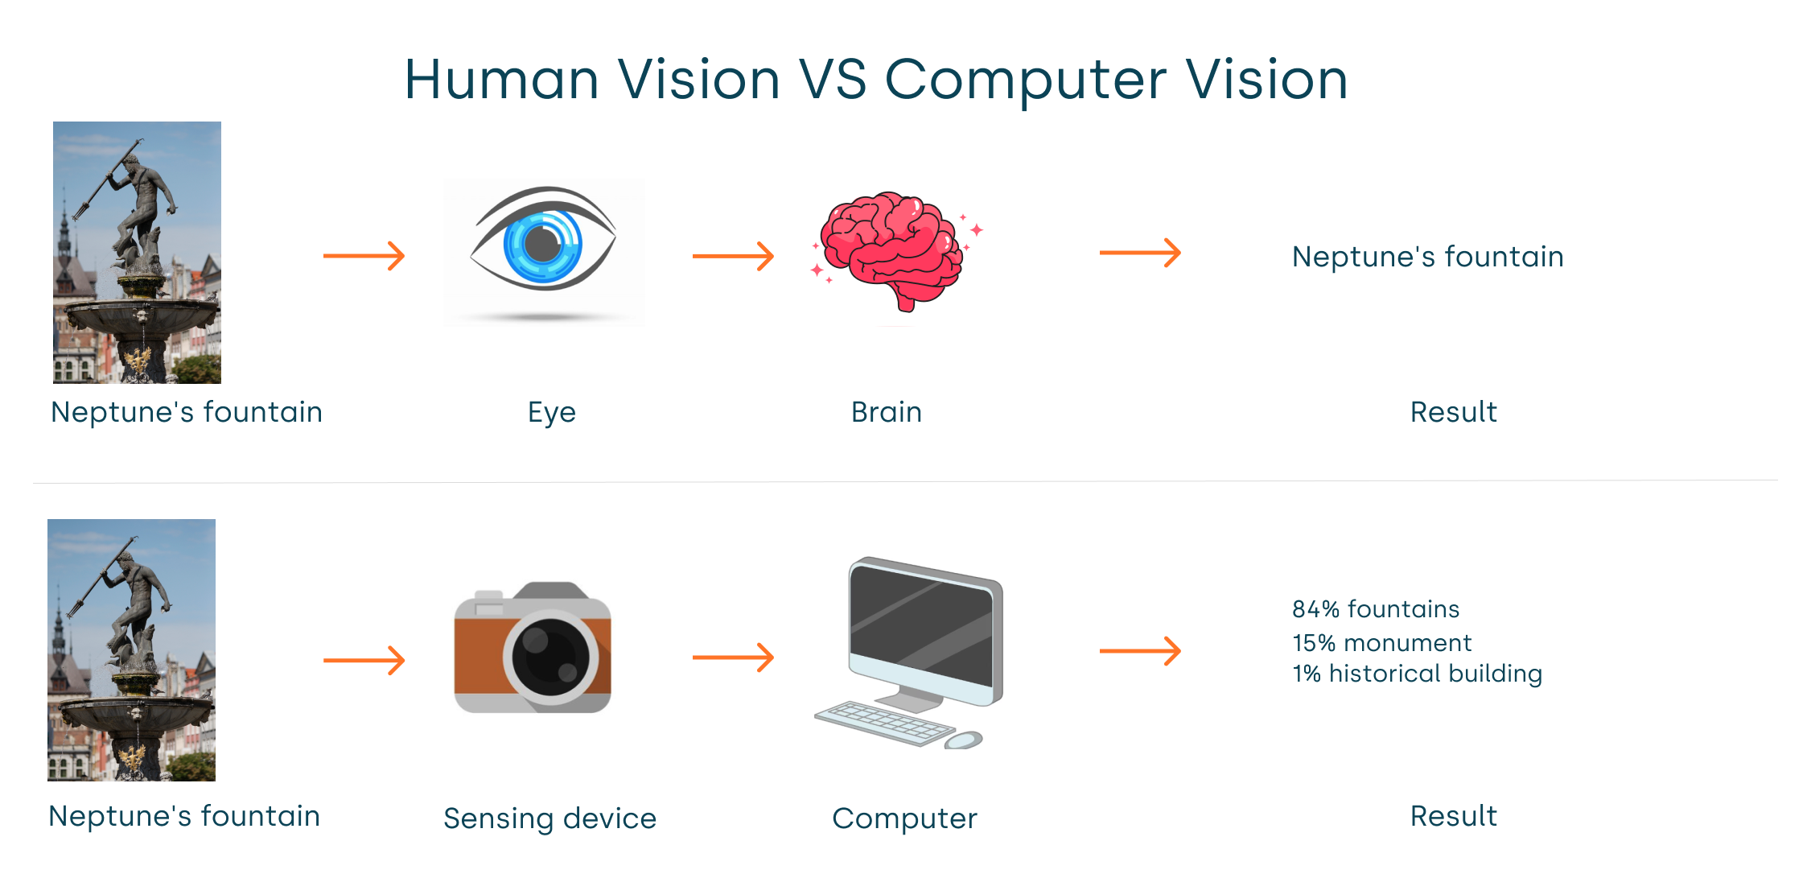




WHAT IS COMPUTER VISION?
A field of AI that enables computers to see and understand images or videos
KEY CAPABILITIES
Image Processing
Video Analysis
Object Detection
Face Recognition
Gesture Recognition

Slide 4







WHAT IS MEDIAPIPE?
A machine learning framework by Google for real-time perception
KEY FEATURES
Hand Tracking
Face Detection
Pose Estimation
Object Detection
Gesture Recognition
Real-Time Processing
60+ FPS

Slide 5










MEDIAPIPE CAPABILITIES
PROJECT APPLICATIONS
WHAT MEDIAPIPE PROVIDES
Ready-made AI Models
Real-Time
Finger
Hand Detection
Landmarks
Pre-trained Pipelines
No Training from Scratch
Hand
Depth
Skeleton
Estimation
Easy Integration
Gesture Controlled Robotics
Using 21 hand landmarks
Project Goal

Slide 6

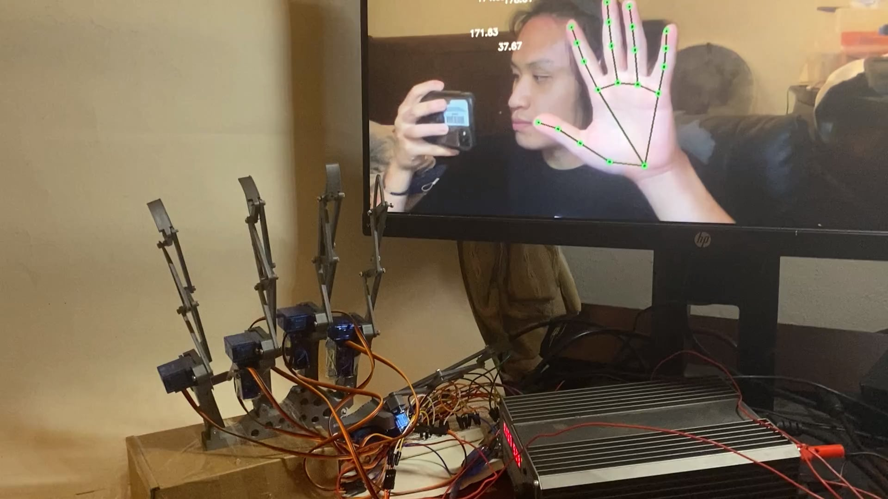






WHY USE MEDIAPIPE?
Instead of training AI models from scratch, MediaPipe provides pre-trained pipelines
Faster Development
Accurate Results
Rapid prototyping
Production-ready
Google Maintained
Cross-Platform
Industry standard
Multiple platforms
Gesture Controlled Robotics
Real-time hand tracking

Slide 7





INSTALLING MEDIAPIPE
Requirements
1
Open Terminal
Launch command prompt or terminal
Python Version
2
Run Command
Python 3.6 - 3.11
Recommended: Python 3.11
3
Wait for Download
Package downloads and installs
Quick Tip
Verify Installation
Use virtual environment for isolated setup
4
60+
21
FPS
Landmarks

Slide 8








TEST INSTALLATION
Expected Output
test_mediapipe.py
MediaPipe version
1
2
Installation Successful
MediaPipe is ready to use
Run Code
Press Enter to execute
Easy Import
Fast Setup

Slide 9








HOW MEDIAPIPE WORKS
BLACK BOX CONCEPT
Training Process
Input Frame
Model trained on large dataset
Images with hand landmarks
Learns to predict positions
Black Box
Model
Pre-Trained Models
No training required
Instant Results
Predicted Output
Ready to use immediately

Slide 10















MEDIAPIPE PIPELINE
PROCESSING WORKFLOW
Camera Frame
OpenCV Capture
Real-Time Processing
Complete pipeline in 60+ FPS
Convert BGR → RGB
MediaPipe Hands Model
Fast
Accurate
Optimized pipeline
Pre-trained models
Detect Hand
Hand Tracking Ready
Return 21 Landmarks
21 landmarks per hand
OpenCV Draws Skeleton

Slide 11

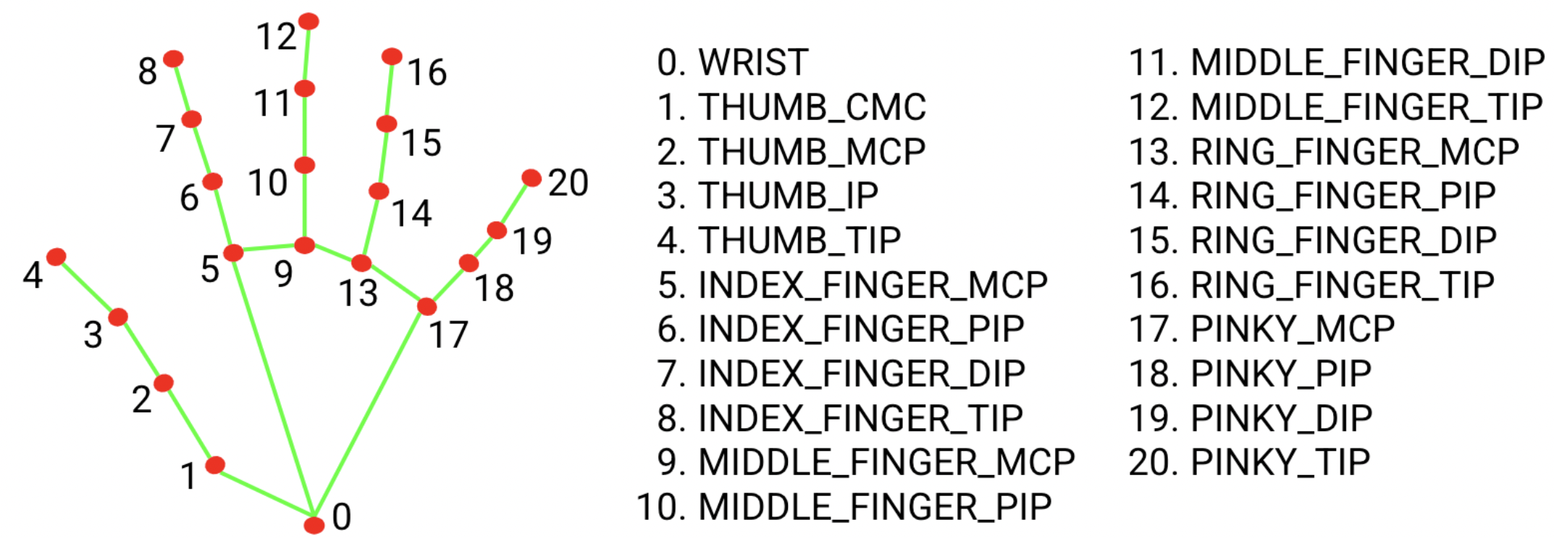




MEDIAPIPE HAND LANDMARKS
21 Key Points
MediaPipe detects 21 key points on each hand and returns them as coordinates in the image
Precise Coordinates
x, y, z position for each point
Real-Time Detection
Instant hand tracking
Calculate Metrics
Angles, length, direction
21
5
3D
Landmarks
Fingers
Coordinates

Slide 12

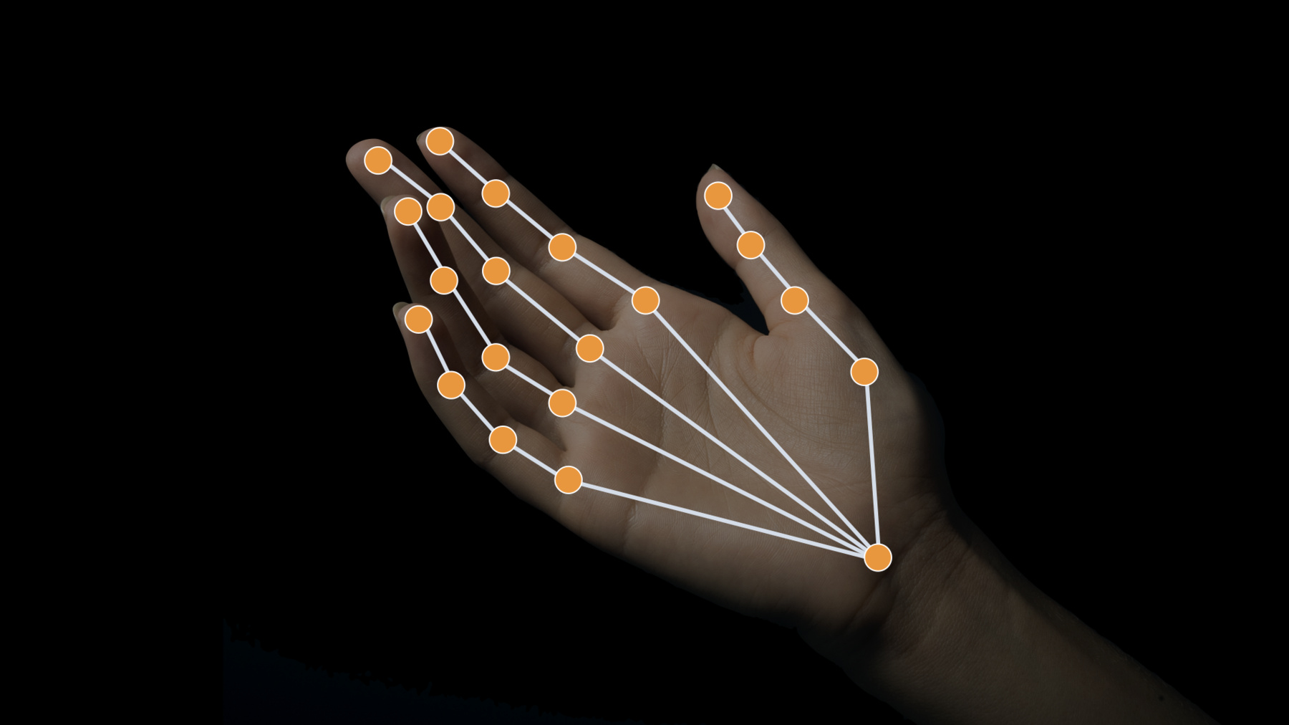
21 LANDMARK POINTS
HAND STRUCTURE
0
Wrist
1-4
Thumb
Base point of hand
4 landmark points
5-8
Index Finger
9-12
Middle Finger
4 landmark points
4 landmark points
13-16
Ring Finger
17-20
Little Finger
4 landmark points
4 landmark points
21
5
3D
Total Points
Fingers
Coordinates

Slide 13





LANDMARK NUMBERS
Point
Meaning
Key Information
0
Wrist
These coordinates are used to calculate:
Finger angle
1-4
Thumb
Finger length
Finger direction
5-8
Index Finger
9-12
Middle Finger
21
5
3D
Points
Fingers
Space
13-16
Ring Finger
Tip
17-20
Little Finger
Point 4, 8, 12, 16, 20 are fingertips

Slide 14


BASIC HAND DETECTION CODE
D1_HandMap.py
CODE STRUCTURE
1
Import Libraries
2
Setup MediaPipe
3
Initialize Webcam
4
Process Frames
5
Detect Hands
6
Draw Landmarks

Slide 15



CODE BREAKDOWN - SETUP
Setup & Initialization
STEP-BY-STEP
1
Import OpenCV
2
Import MediaPipe
Image processing library
Hand tracking framework
3
Setup Hands
4
Drawing Utils
Detection functionality
Skeleton visualization
5
Initialize Webcam
Connect to default camera (device 0)
Note: VideoCapture(0) accesses the default camera

Slide 16

CODE BREAKDOWN - WEBCAM & PROCESSING
Capture & Process Frames
PROCESS FLOW
1
Read Frame
2
Convert Colors
Capture from webcam
BGR → RGB
3
Process Frame
4
Flip Frame
MediaPipe detection
Mirror effect
5
Display & Exit
Show result, press 'q' to quit
Important: OpenCV uses BGR, MediaPipe requires RGB

Slide 17

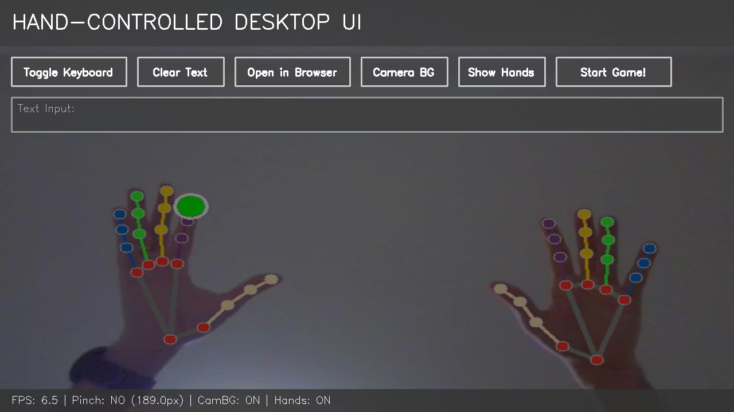
CODE BREAKDOWN - DETECTION & DRAWING
Hand Detection Logic
DETECTION PROCESS
1
Check Detection
2
Iterate Hands
3
Draw Skeleton
Verify hands found
Process each hand
Visualize points
Tip: HAND_CONNECTIONS defines how landmarks connect to form skeleton

Slide 18





IMPORTANT MEDIAPIPE PARAMETERS
Hands Configuration
PARAMETER GUIDE
min_detection_confidence
Minimum confidence threshold for initial hand detection
Range:
0.0 - 1.0 (Default: 0.5)
min_tracking_confidence
Parameter
Value
Type
Confidence threshold for tracking detected hands
min_detection_confidence
0.5
float (0-1)
Range:
0.0 - 1.0 (Default: 0.5)
min_tracking_confidence
0.5
float (0-1)
max_num_hands
1
int
max_num_hands
Maximum number of hands to detect simultaneously
Default:
1 (Set to 2 for both hands)

Slide 19


PARAMETERS EXPLAINED
USAGE GUIDE
Parameter
Meaning
Example
Detection Confidence
min_detection_confidence
Minimum confidence to detect hand
0.5
(50%)
Lower value = more sensitive detection Higher value = fewer false positives
min_tracking_confidence
Confidence to track hand
0.5
(50%)
Tracking Confidence
max_num_hands
Maximum hands detected
Controls tracking stability Higher value = more stable tracking
2
(Both hands)
Max Hands
Dual Hand Tracking Example
Set to 1 for single hand Set to 2 for dual hand tracking

Slide 20

GETTING LANDMARK COORDINATES
Coordinate Extraction
COORDINATE SYSTEM
X
Horizontal Position
Normalized 0.0 - 1.0
Formula:
pixel_x = lm.x * width
Y
Vertical Position
Normalized 0.0 - 1.0
Formula:
pixel_y = lm.y * height
Z
Depth Information
Relative depth from camera
Formula:
pixel_z = lm.z * width
Note: All coordinates are normalized between 0-1, multiplied by frame dimensions to get pixel values

Slide 21



RESULTS OBJECT STRUCTURE
results Object Hierarchy
STRUCTURE DETAILS
results
Result Object
1
results
Main object returned from MediaPipe processing
multi_hand_landmarks
Collection of hands
2
multi_hand_landmarks
├─
Hand_Landmarks 1
21 points
List containing all detected hands
├─
Hand_Landmarks 2
21 points
Hand_Landmarks
3
└─
Hand_Landmarks 3
(if visible)
Each hand contains 21 landmark points
multi_handedness
Left / Right
Access Example
multi_hand_world_landmarks
3D coordinates
21
3D
Points per Hand
Coordinates

Slide 22




ACCESSING HAND LANDMARKS
1
Iterate Through Detected Hands
PROCESS FLOW
Filter Results
Check if hands were detected
Loop Through Hands
Process each detected hand
2
Draw Hand Skeleton
Draw Skeleton
Visualize landmarks and connections
Tip: HAND_CONNECTIONS defines how landmarks are connected to form the hand skeleton

Slide 23




COORDINATE SYSTEM
Conversion to Pixels
3D COORDINATES
X
Horizontal Position
Normalized
Left to Right
0.0 - 1.0
Y
Vertical Position
Normalized
Top to Bottom
0.0 - 1.0
Z
Depth Position
Relative
Near to Far
± Depth
Frame Shape
Range
height × width × channels
Normalized coordinates
Z Depth: Negative values = near camera, Positive values = away from camera
h, w, c
0.0 - 1.0
2D
3D
21
Pixel Coordinates
Depth Information
Landmarks

Slide 24

PRINT LANDMARK POSITIONS
D2_Landmarks.py
Complete Hand Landmark Printer

Slide 25





CODE WALKTHROUGH
1
2
3
4
Initialize MediaPipe
Capture Video
Convert Colors
Detect Hands
Setup hands and drawing
Open webcam stream
BGR to RGB space
Process frame
5
6
7
Loop Through Hands
Extract Coordinates
Print Output
Iterate each detected hand
Get x, y, z for each landmark
Display coordinates
Key Code Snippets

Slide 26



HIGHLIGHTING FINGER TIPS
What This Does
D3_FingerTips.py
Highlights all 5 fingertip landmarks with green circles on the video feed
Common Use Cases
• Gesture recognition • Touch detection • Finger tracking • Hand pose analysis
Visual Indicator
Green circle on fingertips
Radius: 10 pixels
4
8
12
16
20
Thumb
Index
Middle
Ring
Little
5
21
BGR
Finger Tips
Total Landmarks
Color Format

Slide 27



FINGER TIPS CODE
D3_FingerTips.py
Highlight Finger Tips
Expected Output
Green circles on all 5 fingertips
4
8
12
16
20
Thumb
Index
Middle
Ring
Little
tips = [4, 8, 12, 16, 20]
if idx in tips:
cv2.circle(..., 10, (0,255,0), -1)
5
10
BGR
Tips
Radius
Green

Slide 28

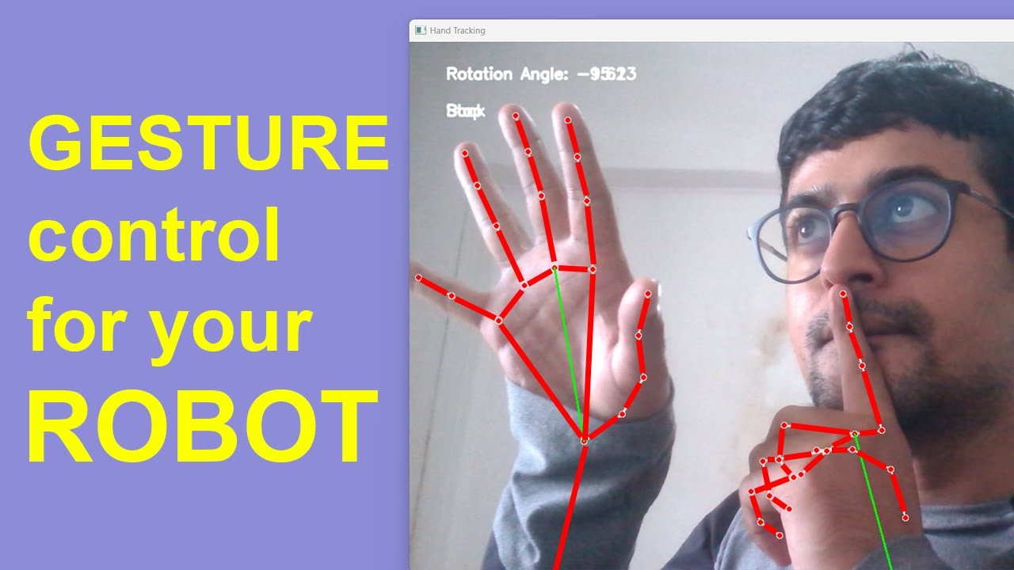








PRACTICAL APPLICATIONS
Gesture Robotics
AR/VR Interfaces
Control robotic hands with gestures
Natural hand interaction in virtual worlds
Sign Language
Gaming Controls
Translate sign language to text
Motion-based gaming interfaces
Medical Apps
Smart Home
Rehabilitation and therapy tracking
Gesture-based automation control
Key Advantages
60+
21
3D
Real-time processing
No specialized hardware needed
FPS Processing
Landmark Points
Coordinate System
Cross-platform compatibility
High accuracy detection

Slide 29














BEST PRACTICES & RESOURCES
TIPS FOR SUCCESS
LEARN MORE
Optimize Parameters
MediaPipe Documentation
Adjust detection confidence for your use case
Official guides and API reference
Handle Multiple Hands
OpenCV Tutorials
Set max_num_hands appropriately
Video processing and image manipulation
Use Z-Coordinate
Enable depth-based interactions
GitHub Examples
Sample projects and implementations
Mirror Effect
Flip frame horizontally for natural interaction
Community Forums
Get help from other developers
Performance
Optimize frame size for real-time processing
21
60+
100%
Landmarks
FPS Speed
Open Source
Lighting Conditions
Ensure good lighting for better detection

Slide 30






THANK YOU
Questions & Discussion
Ansik Singh Tomar (Aanshik)
COORDINATOR - TECHNOCRATS
Keep Coding, Keep Learning!
MediaPipe & Computer Vision Workshop • Hand Tracking with AI

